Slide 1
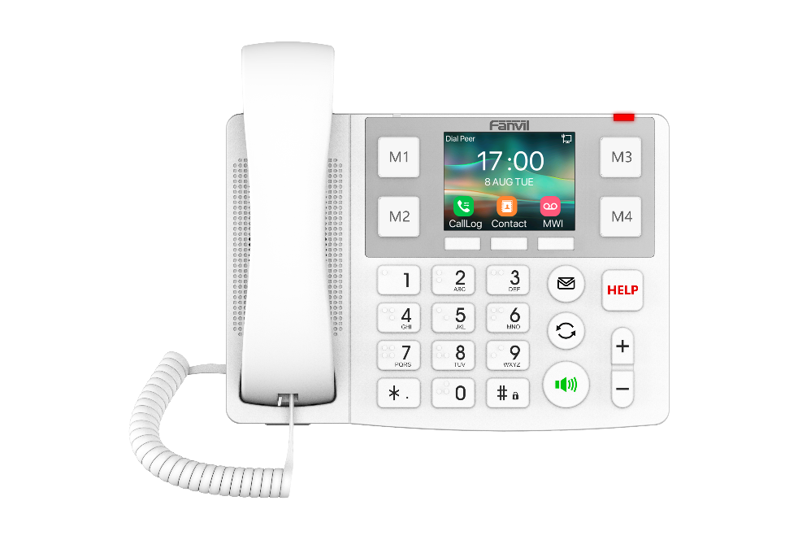
Fanvil X305 Big Button IP Phone
Product Introduction

Slide 2
1
2
CONTENTS
Product Overview
Highlights
3
4
Application Scenarios
Comparisons

Slide 3
Product Overview
01

Slide 4
X305 Big Button IP Phone
X305 is a big button IP phone designed for nursing homes, hospital, and other scenarios.
X305 features a 3.5-inch color screen and big buttons, supporting 2 SIP lines and PoE power supply to offer user-friendly experience. It has built-in 2.4GHz & 5GHz Wi-Fi, and supports 433MHz wireless buttons, providing an efficient and high-quality communication experience for seniors.

Slide 5
Specification
OS | Linux
LCD | 3.5" 320 x 240-pixel color screen
SIP Line | 2
Side Keys | 4
Contacts | 1000
Wi-Fi | 2.4GHz & 5GHz
433MHz Wireless Button | KT 1x/2x/3x Series
Handset | HAC
Number keys | Braille Dots
Wideband codec | G.722, Opus
networks | 10/100/1000 Mbps
Power | PoE/PSU
Installation | Desktop Stand/Wall Mountable

Slide 6
Physical Buttons
Replaceable Speed Dial Buttons
One-click Call
3.5”Color Screen
Humanized UI Design
HELP Button
Emergency Call
Big Button
Speakerphone
Braille Dots

Slide 7
Highlights
02

Slide 8
1.Elegant and Fashionable Appearance

Slide 9
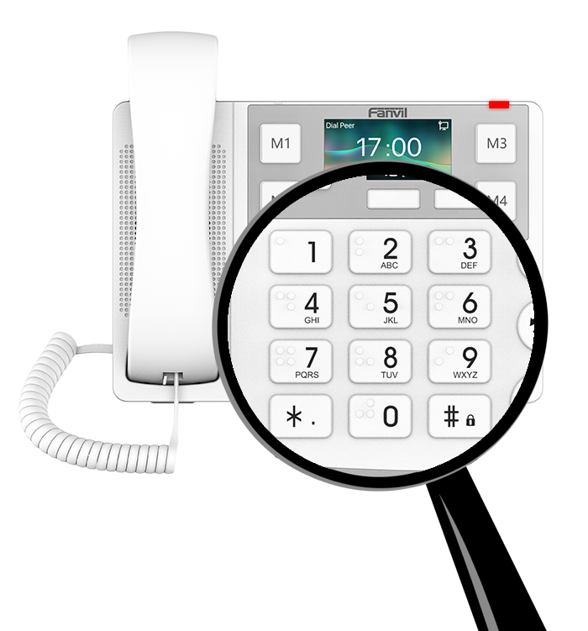
2. Braille Number Key for Hassle-Free Accessibility
X305 features 10 braille digit keys, enhancing accessibility for users with visual impairments. This thoughtful design promotes inclusivity and ensures that everyone can make calls with ease.

Slide 10
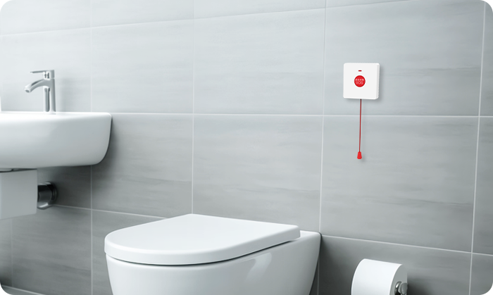
3. One-click Call, Around-the-Clock Protection
With a conspicuous HELP button and portable 433MHz wireless buttons (Fanvil KT 1x/2x/3x Series), the X305 provides you with 24/7 protection. One-click call for help when you are in emergency situations.
KT10
KT20
KT30
*433MHz wireless buttons are to be ordered separately.

Slide 11
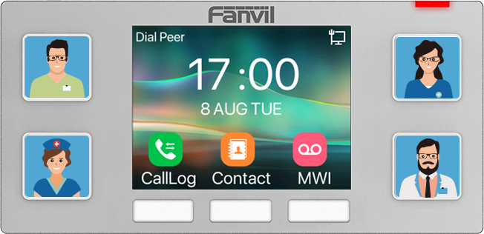
4. Speed Dial Buttons, Customized at Your Fingertips
X305 is equipped with four speed dial buttons that support image customization for quick contact access. With personalized number settings, it enables one-click dialing without the need to memorize phone numbers.

Slide 12
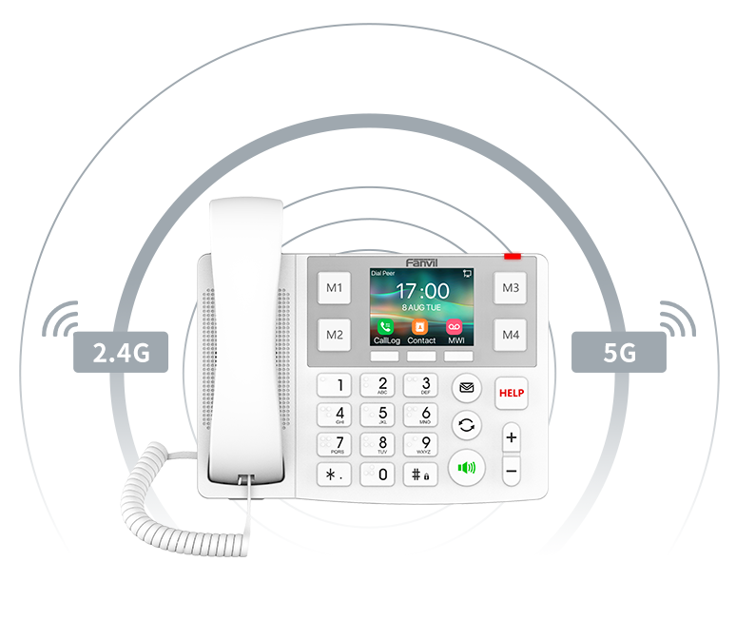
5. Dual-band Wi-Fi，Flexible Deployment
X305 has built-in 2.4GHz & 5GHz Wi-Fi, supporting wireless connectivity, providing users with more options in network modes.
The reduction of network wiring greatly reduces the difficulty of deployment.

Slide 13
Application Scenarios
03

Slide 14
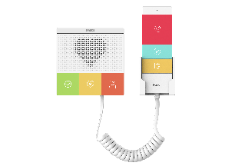
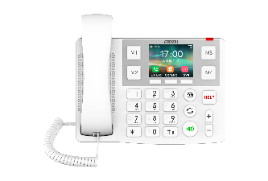
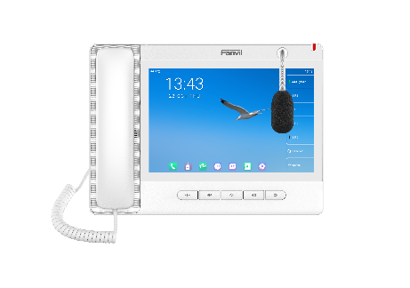
Nursing Home
When an elderly person in the room faces an emergency, they can press a button to call the nurse, who will provide immediate assistance. Speed dial functionality can also facilitate communication and interaction between the elderly and their relatives and friends.
Room
Room
Front Desk
Pubilc Area

Slide 15
Comparisons
04

Slide 16
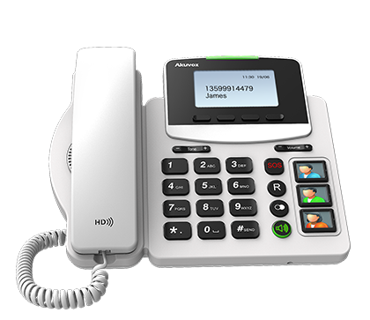
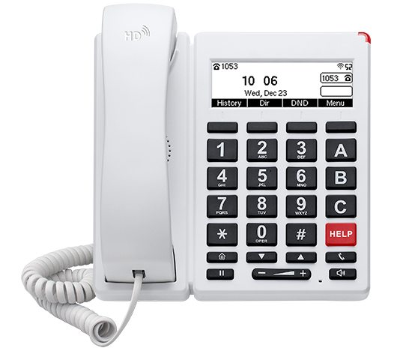
Comparisons
Model | X305 | R15P | FIP12WP
Picture
OS | Linux | Linux | Linux
LCD | 320x240 3.5”color screen | 132x64 2.9”Dot-matrix screen | 192x64 3.5”Dot-matrix screen
SIP Line | 2 | 1 | 2
Audio Conference | 6-way | 3-way | 3-way
Wireless Pendant Key | √(433MHz) | √ | x
Call Logs | 600 | 100 | 60
Braille | √(number keys） | x | x
WiFi | 2.4GHz & 5GHz Wi-Fi | x | 2.4GHz Wi-Fi
IP Mode | IPV4/IPV6 | IPV4/IPV6 | IPV4/IPV6
Networks | 2X10/100/1000 Mbps | 2X10/100Mbps | 2X10/100Mbps
Wideband Codec | G.722, Opus | G.722 | G.722, Opus
Desk Stand | √ | √ | √

Slide 17
THANKS

